Slide 1
Fruit

Slide 2
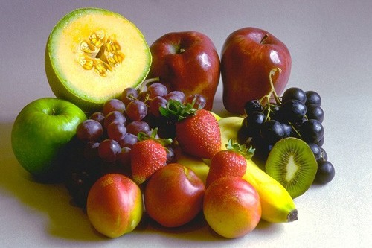

Slide 3
Grapes

Slide 4
Pineapple

Slide 5
Bananas

Slide 6
Orange

Slide 7
Apple

Slide 8
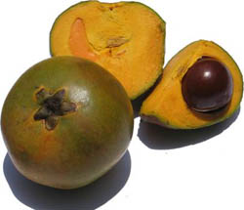
lucumas

Slide 9
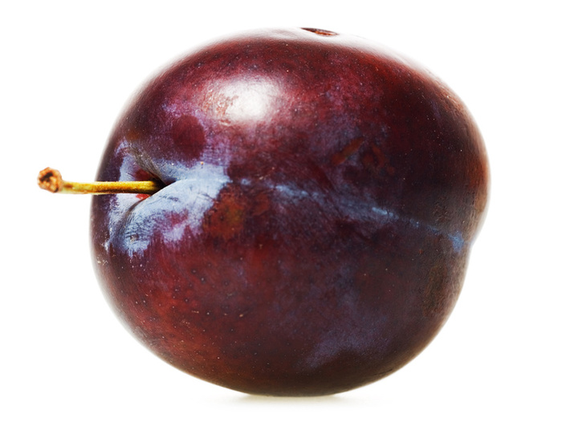
Plum

Slide 10
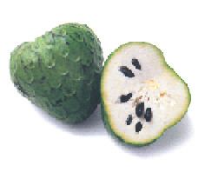
Cherimoya / custard apple

Slide 11
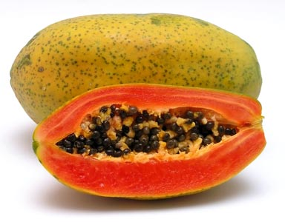
Papaya

